Slide 1



Predicting Coupon Acceptance on E-commerce Platforms
A Machine Learning Approach to Enhancing E-Commerce Business Performance
Prasen Waikar
8/02/2025

Slide 2


Phase 1: Understanding the Data
Data Synopsis
1
Dataset shape
2
12,684 rows 25 columns of customers data.
3
Feature Characteristics
4
User Demographics – Age, Gender, Marital Status, Education, Occupation, and Income
5
6
Behavioral Patterns – Frequency of visits to coffeehouses, restaurants, and bars.
7
8
Travel Scenarios – Destination, weather conditions, temperature, and whether the user was traveling alone or with someone.
9
10
11
Coupon Details – Type of coupon, its expiration time, and distance to the venue
12

Slide 3
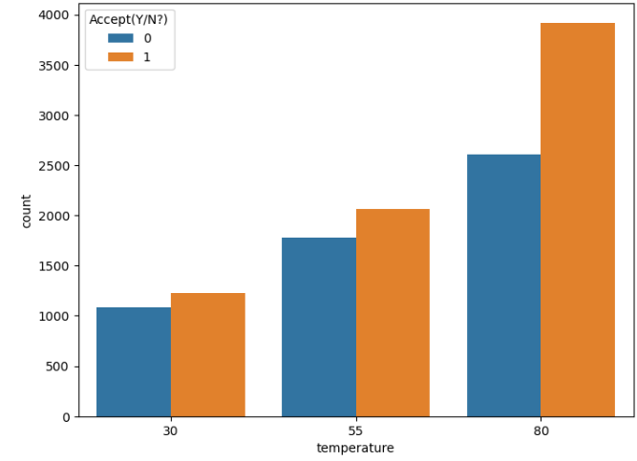
Phase 2: Data Exploration & Key Findings
Weather & Travel Conditions
1
2
3
4
5
6
7
8
9
10
11
12
Customers were more likely to accept coupons on sunny days (60% acceptance rate).

Slide 4
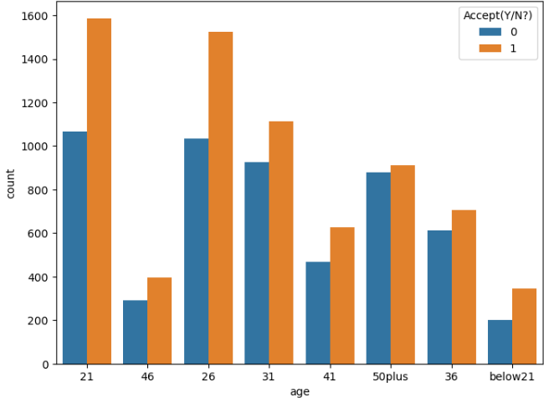
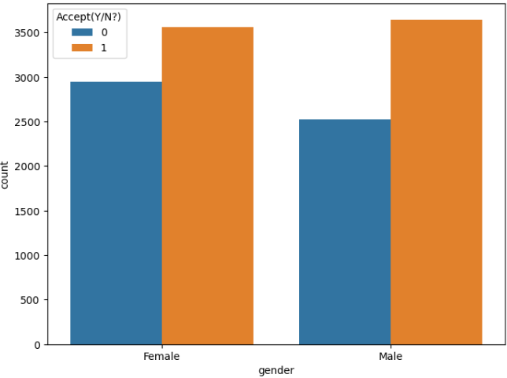
Age & Gender Influence
1
2
3
4
5
6
7
8
9
10
11
Younger customers (21–36) had the highest acceptance rate, while men were slightly more likely to accept coupons than women.
12

Slide 5
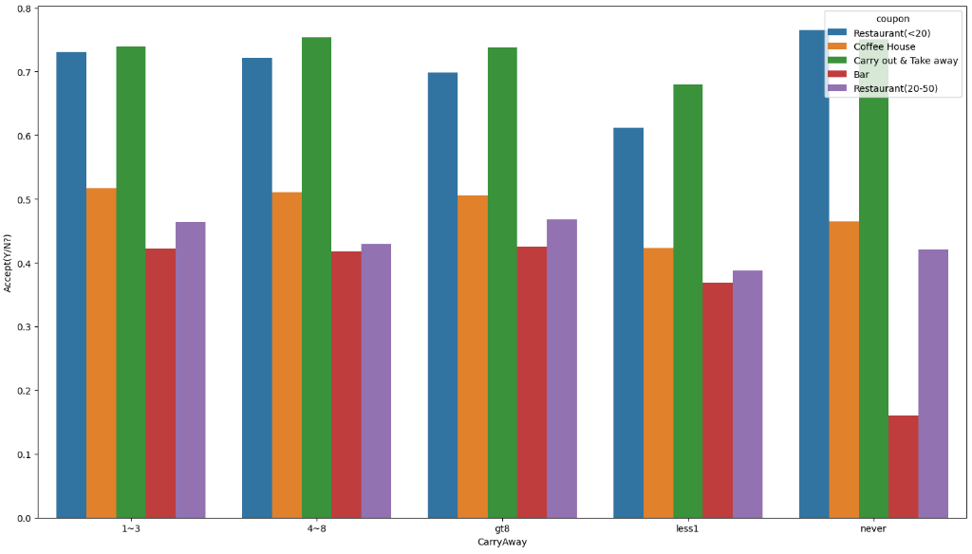
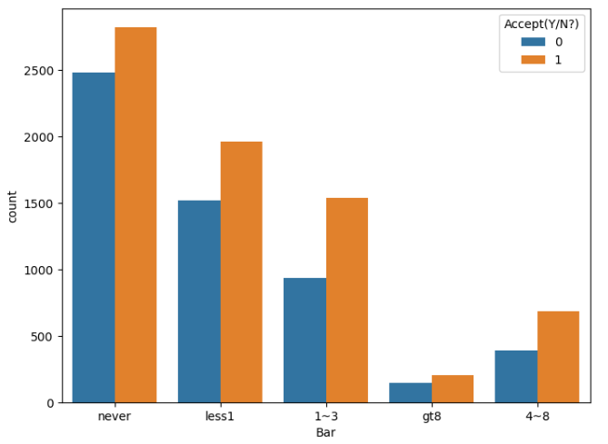
Coupon Type Matters
1
2
3
4
5
6
7
8
9
10
11
Carry-out & Takeaway coupons had the highest acceptance rate (73%), while Bar coupons were least accepted.
12

Slide 6
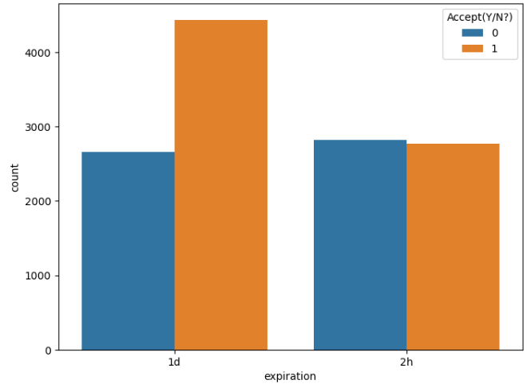
Urgency & Expiry Time
1
2
3
4
5
6
7
8
9
10
11
Most coupons has expiration of 1 day.
62% of coupons are accepted that has expiration of 1 day
12

Slide 7
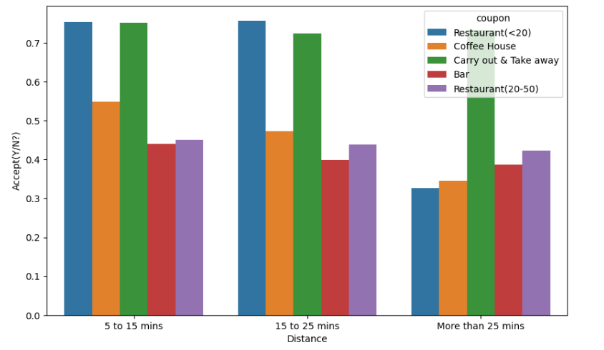
Travel Distance
1
2
3
4
5
6
7
8
9
Count of coupon utilization is more in 15 to 25mins of drive.
Coupon acceptance rate is more(61%) in 5 to 15mins of drive.
Customers who don't like to drive for long (5 to 15mins drive) accept coupons for Restaurant with avg expense less than 20 and Carry out & Take away.
Customers who like to drive for long (More than 25mins) accept coupons for Carry out & Take away more.
While driving customers prefer restaurant types coupons more.
10
11
12

Slide 8
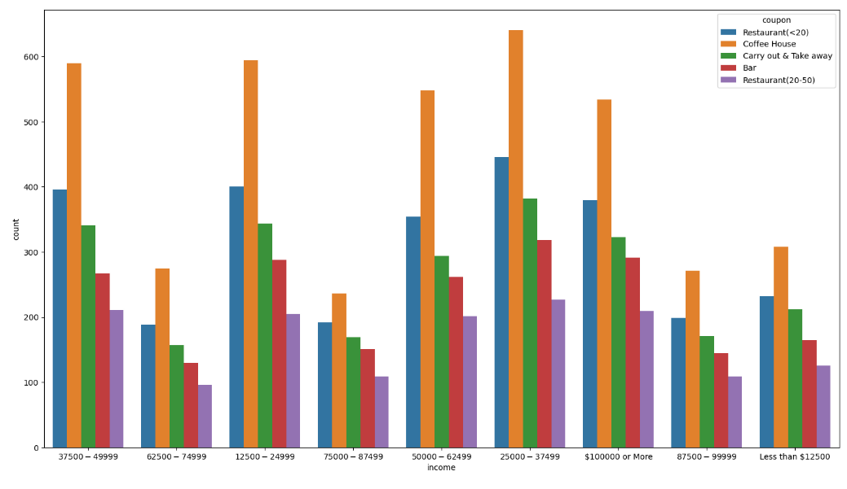
Income of customers
1
2
3
4
5
6
7
8
9
Most customers are having income in the range between 25000 - 37499 and most of the coupons are accepted in this range.
Customers with the income range of : (25000-37499),(50000-62499),(less than $12500),has high acceptance rate of 59%.
Acceptance of Coffee House coupons is highest in income of 25000-37499.
Income range of 62500-74999 has the least amount of customers accepting coupons.
10
11
12

Slide 9

Phase 3: Model Building
Data Preprocessing
1
Before feeding the data into machine learning models, we needed to clean, transform, and prepare it for optimal performance.
2
3
Handling Missing Values
Encoding Categorical Variables
Feature Engineering & Selection
Feature Scaling
4
5
6
7
Model Selection & Training
8
Train-Test-Split
Standardization
9
Algorithm’s Used
10
Logistic Regression
Decision Tree
Random Forest
K-nearest neighbor
Gradient boosting classifier
11
12

Slide 10
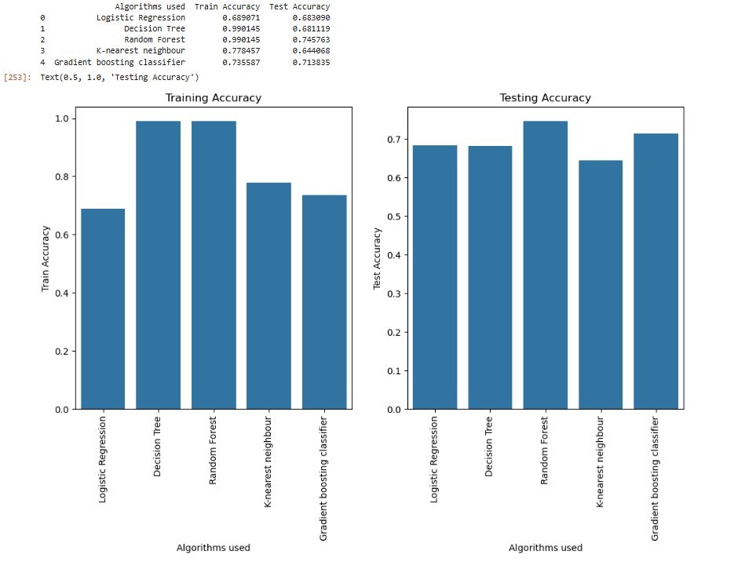
Algorithms and Accuracy
1
2
3
4
5
6
7
8
9
10
11
12

Slide 11
Phase 4: Business Impact & Recommendations
1
2
Target Young & Single Customers: Since they had the highest acceptance rate, sending them time-sensitive coupons could drive engagement.
Prioritize Carry-Out & Takeaway Offers: These were the most redeemed coupons, making them the best choice for promotions.
Optimize Expiry Times: Coupons with a 1 day validity window performed better than those with shorter expiration times.
Consider Travel Conditions: Coupons should be geotargeted to customers driving in the same direction as the venue to increase acceptance.
3
4
5
6
7
8
9
10
11
12

Slide 12
Conclusion
1
2
This project demonstrated how machine learning can be leveraged to predict coupon acceptance behavior among users based on various factors such as demographics, shopping habits, travel patterns, and external conditions like weather. By following a structured data science workflow data preprocessing, feature engineering, model selection, evaluation. I successfully built an accurate and interpretable model that provides valuable insights for e-commerce businesses.
3
4
5
6
7
This project highlights how machine learning can revolutionize targeted marketing strategies in e-commerce. By using predictive analytics, businesses can optimize coupon distribution, improve user engagement, and drive revenue growth. The insights gained from this model demonstrate the power of data-driven decision-making, reinforcing the importance of machine learning in the modern digital economy.
8
9
10
11
12

Slide 13
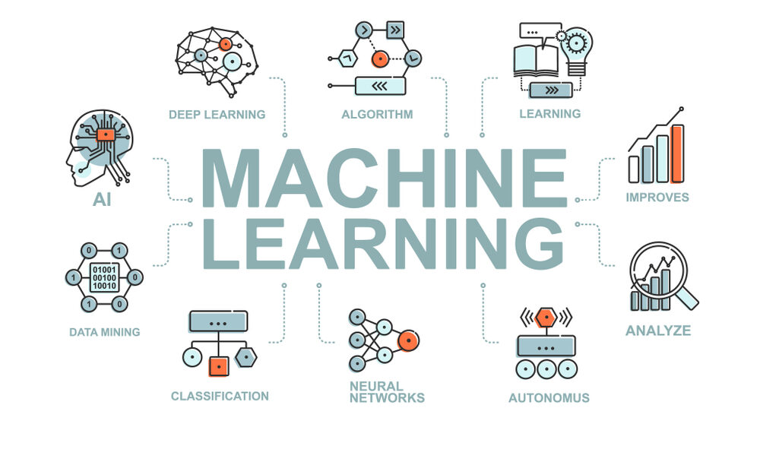
1
2
3
4
Thank
you
5
6
7
8
9
10
11
12

